Slide 1
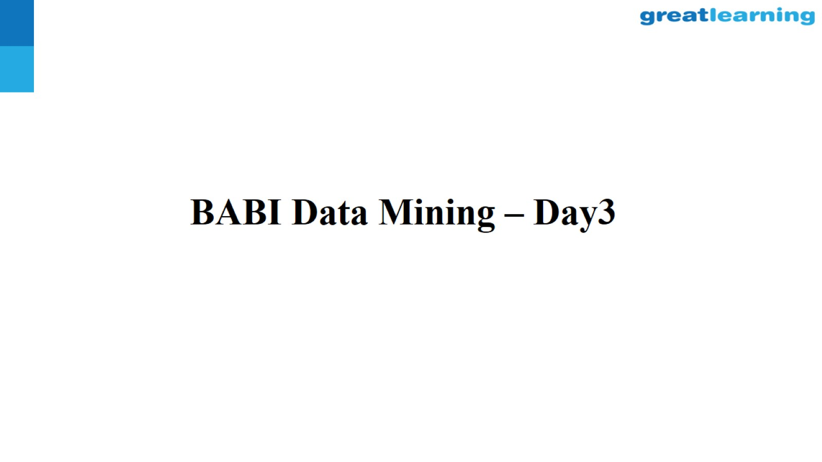
BABI Data Mining – Day3

Slide 2
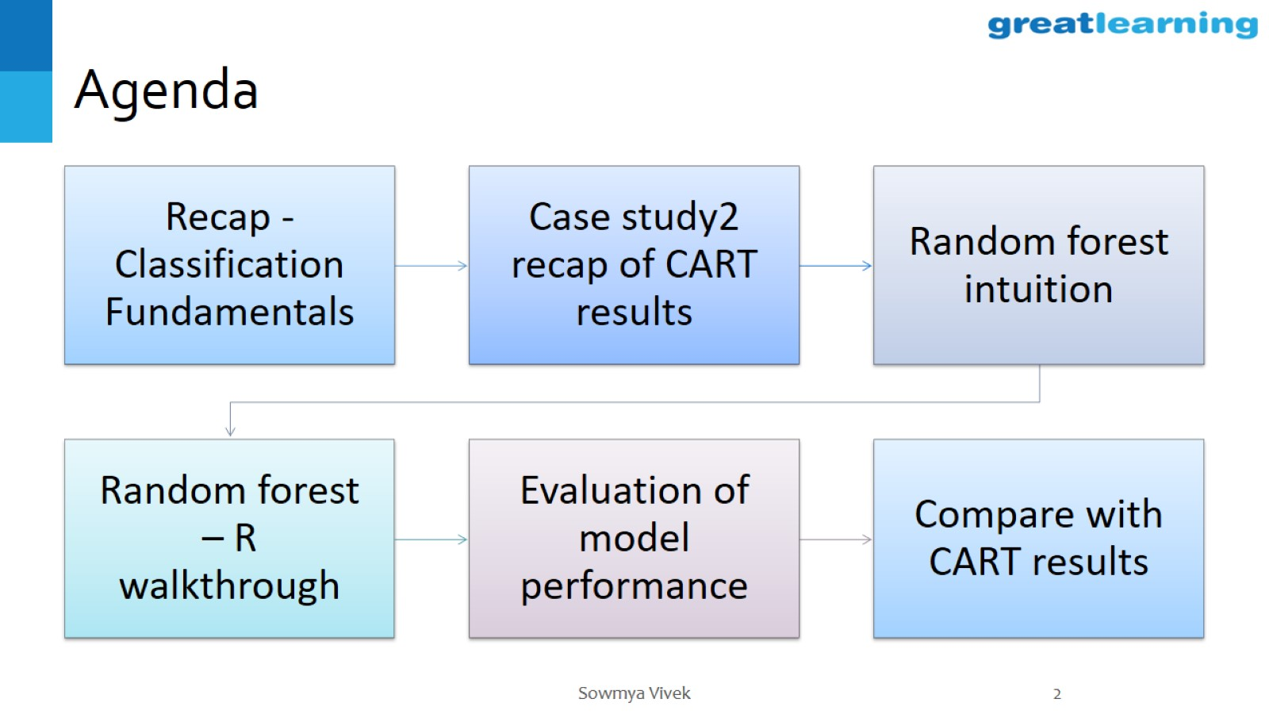
Agenda

Slide 3
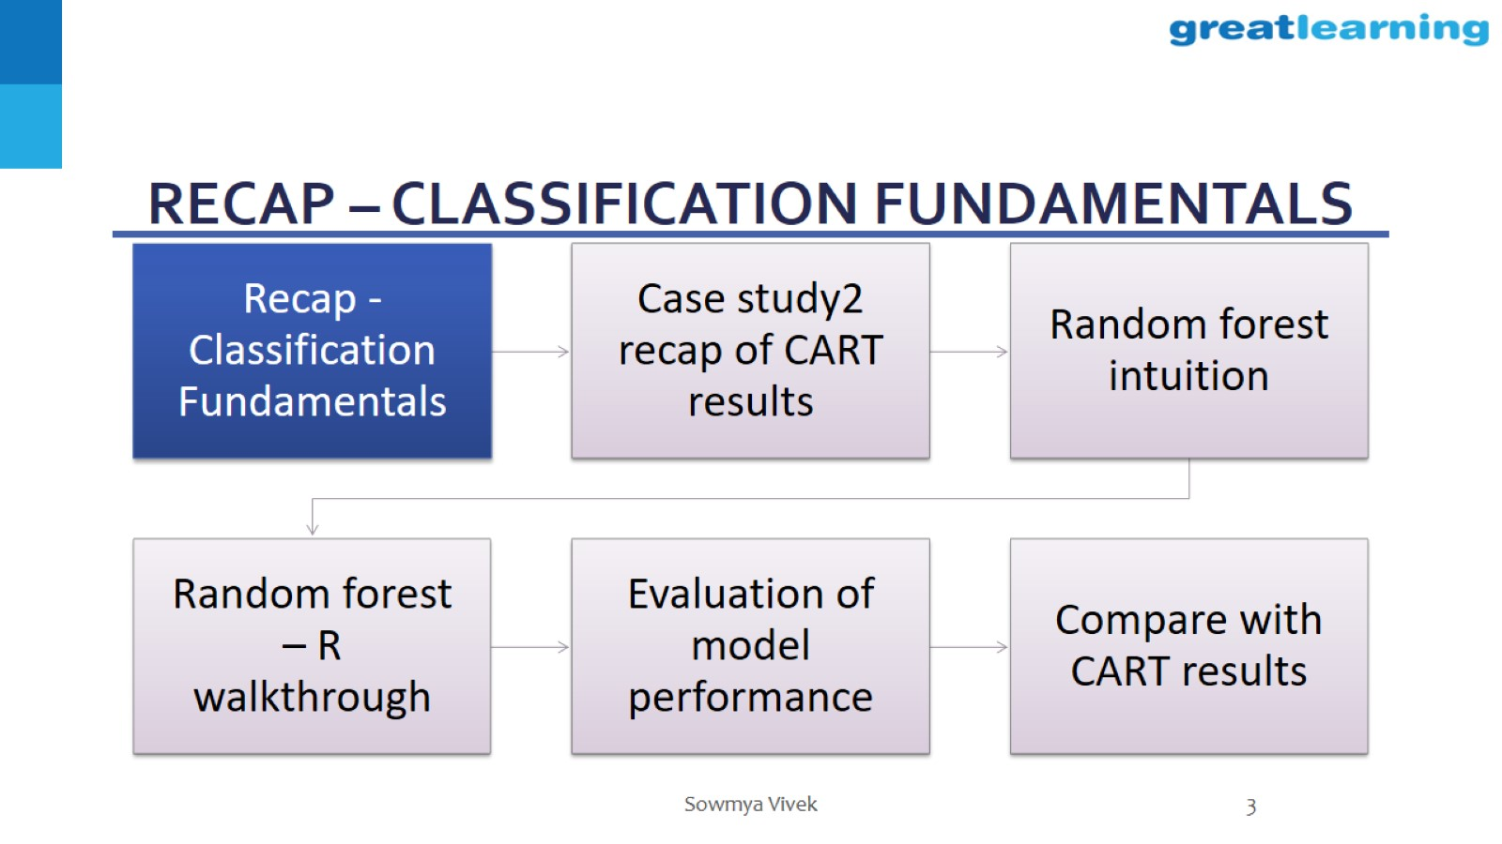
RECAP – classification fundamentals

Slide 4
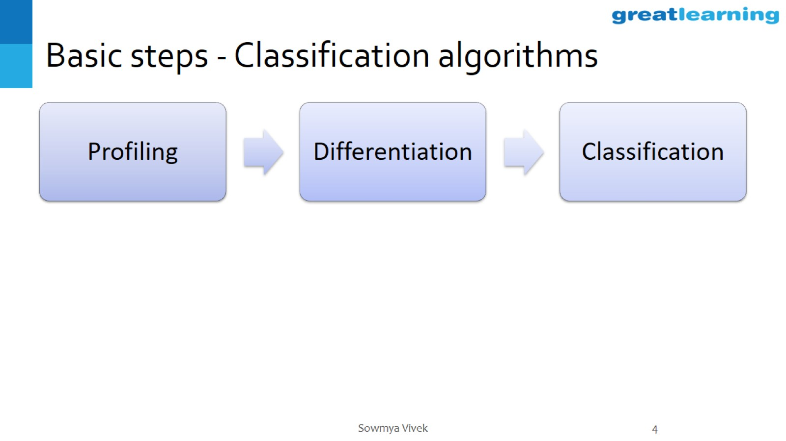
Basic steps - Classification algorithms

Slide 5
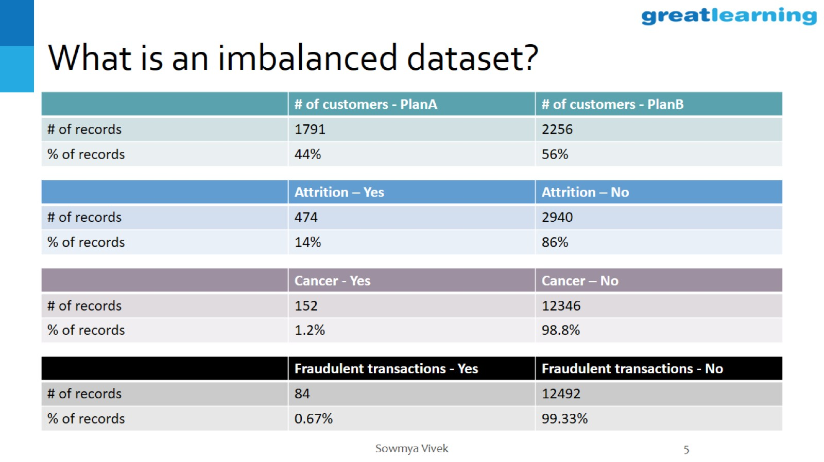
What is an imbalanced dataset?

Slide 6
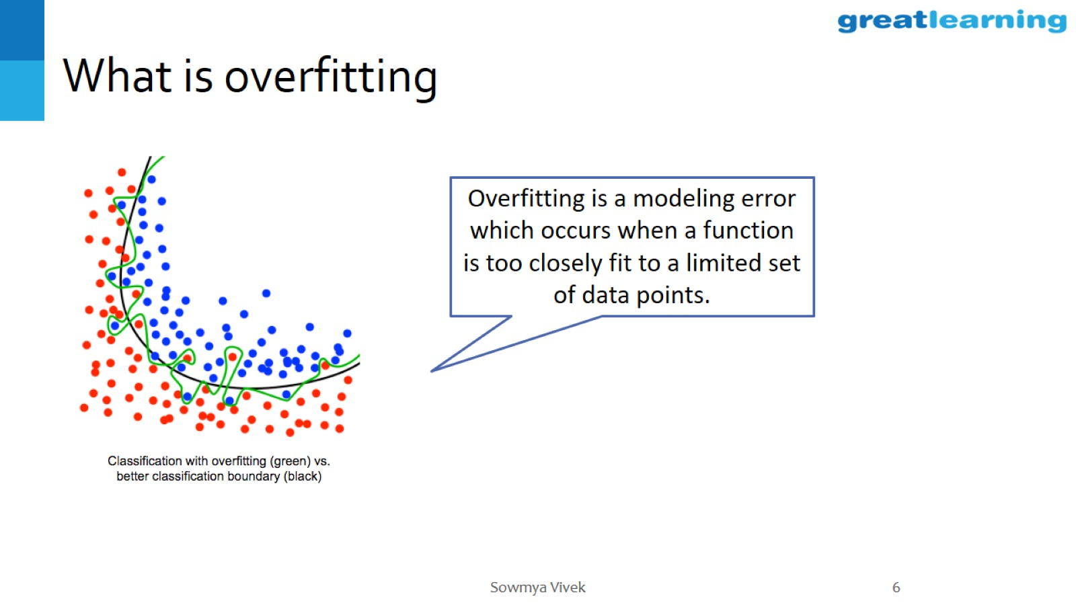
What is overfitting

Slide 7
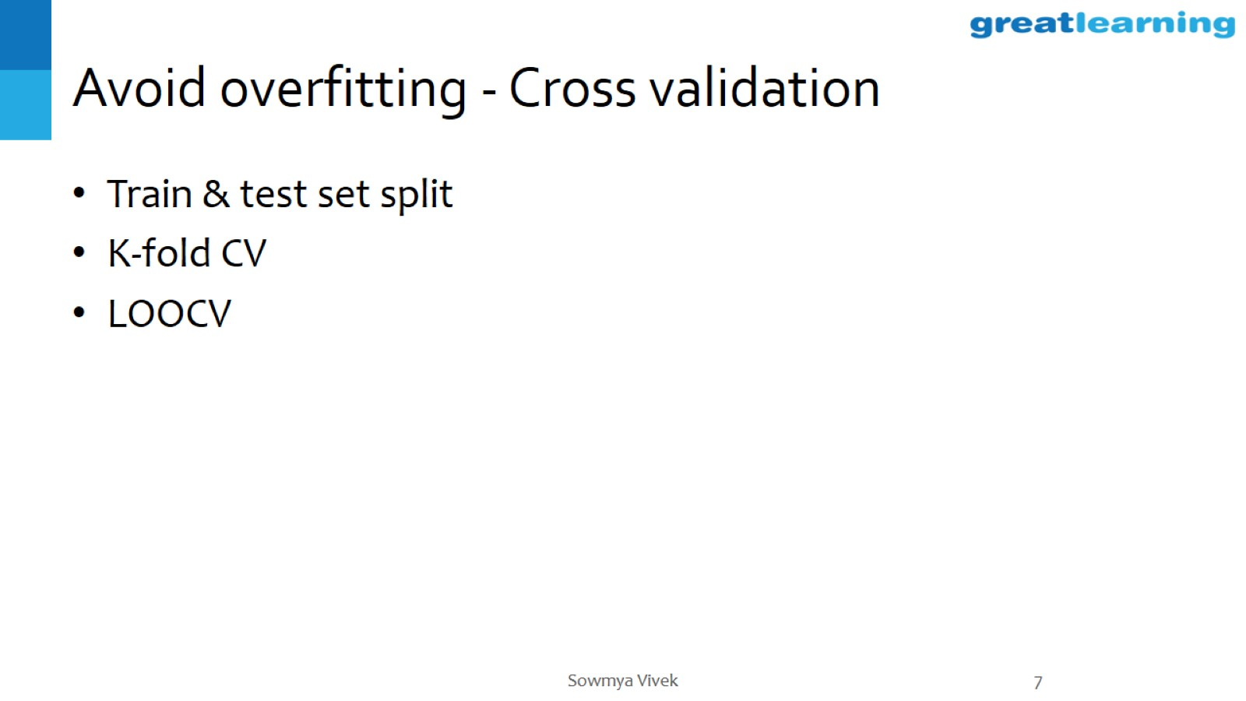
Avoid overfitting - Cross validation

Slide 8
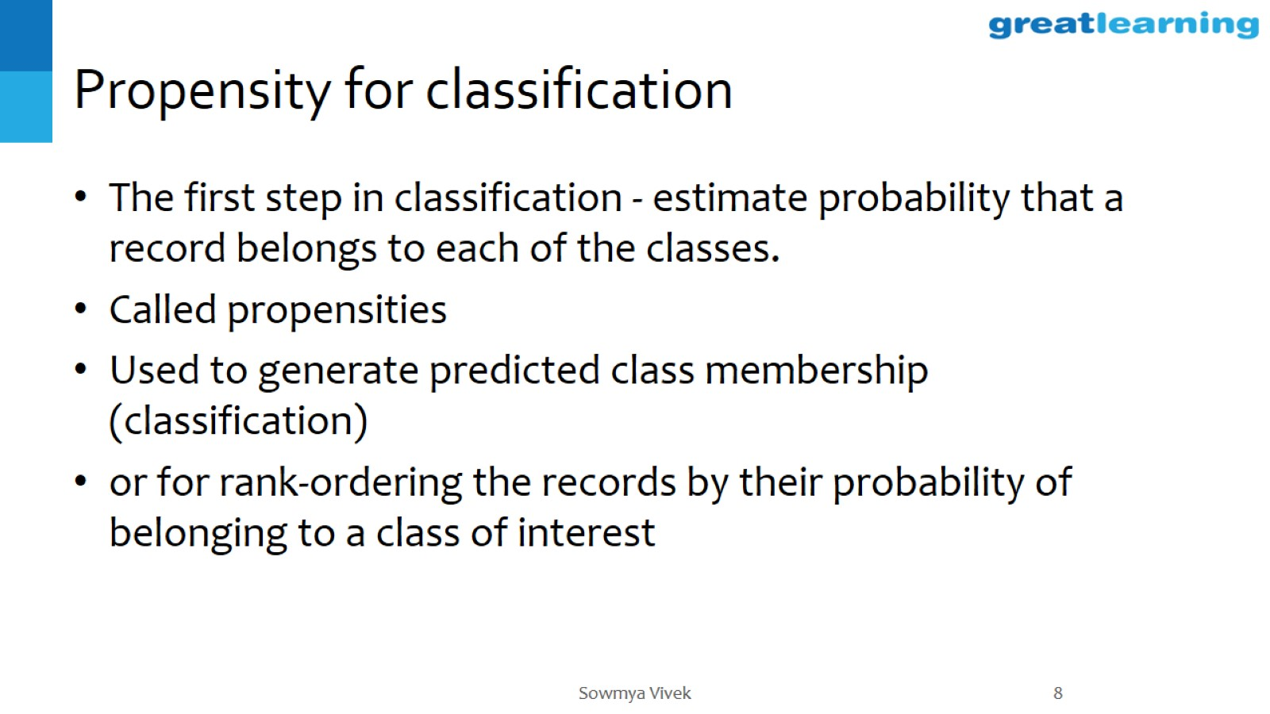
Propensity for classification

Slide 9
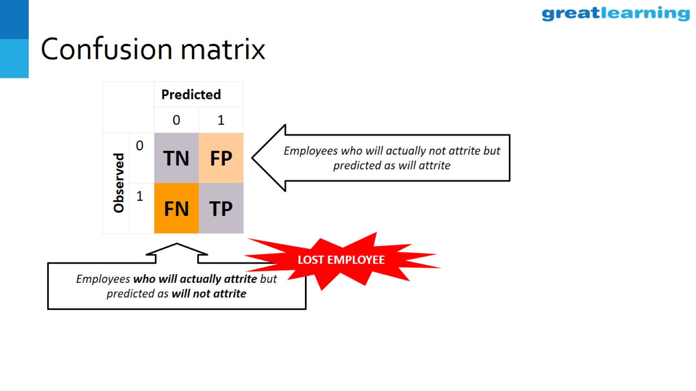
Confusion matrix

Slide 10
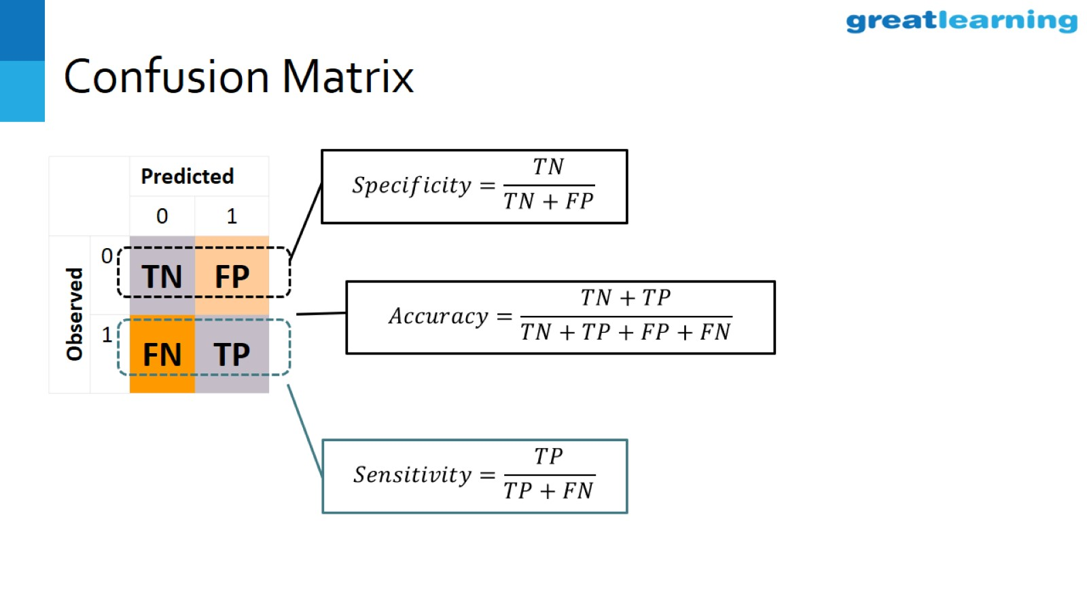
Confusion Matrix

Slide 11
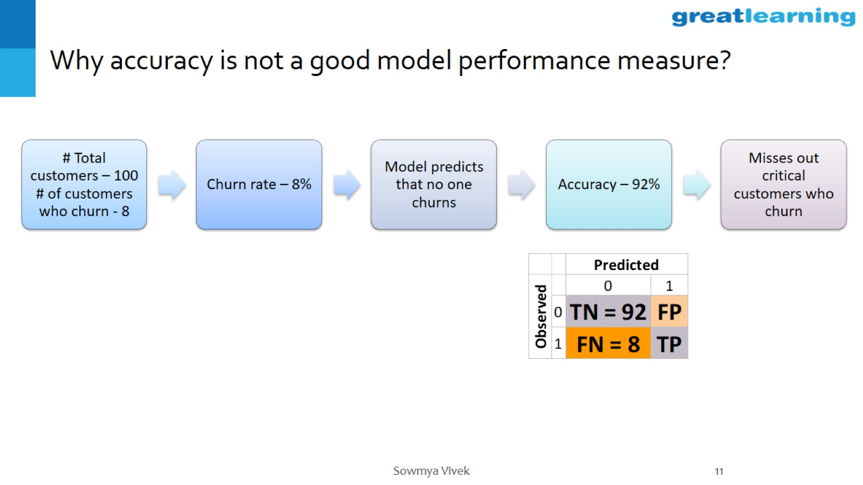
Why accuracy is not a good model performance measure?

Slide 12
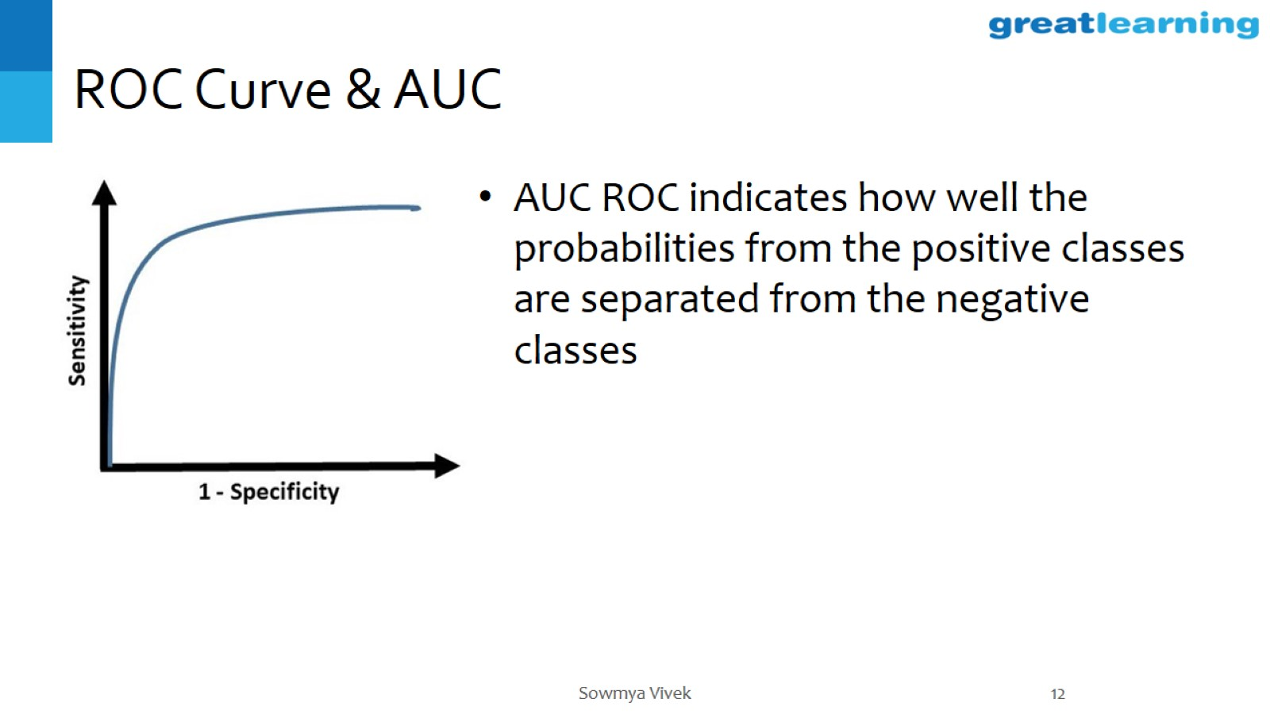
ROC Curve & AUC

Slide 13
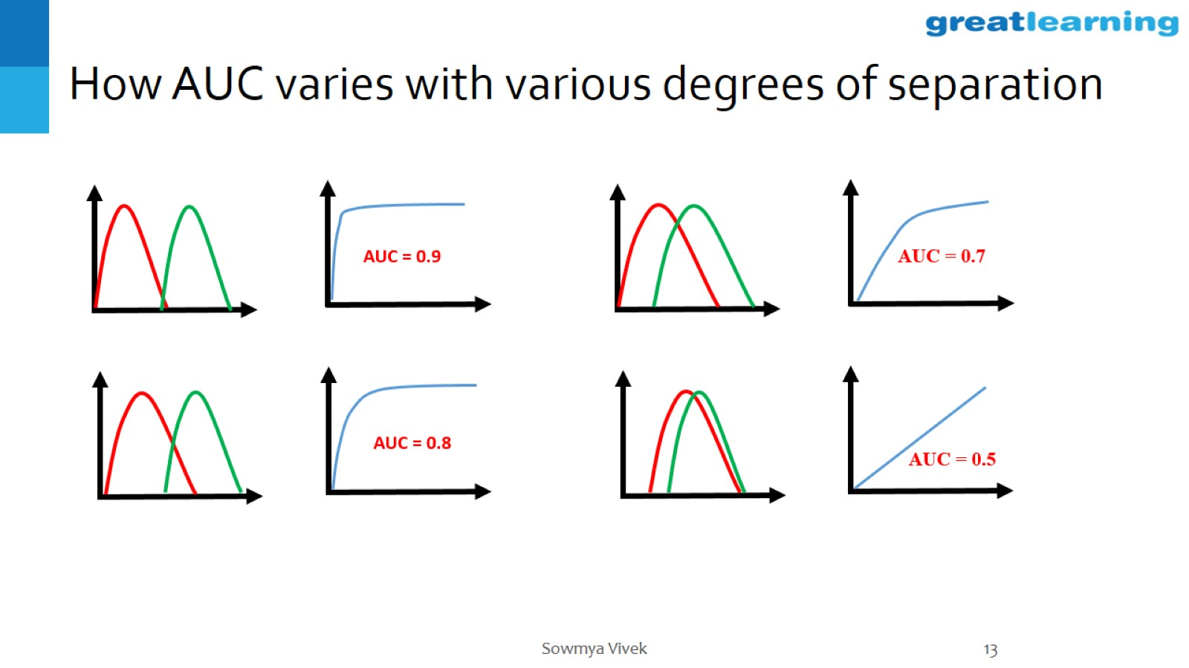
How AUC varies with various degrees of separation

Slide 14
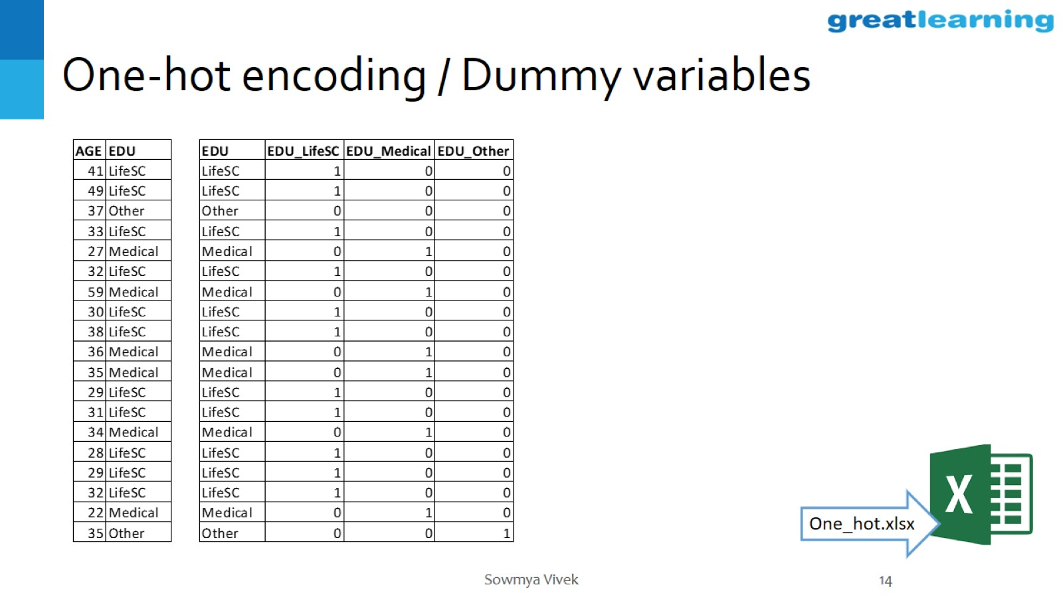
One-hot encoding / Dummy variables

Slide 15
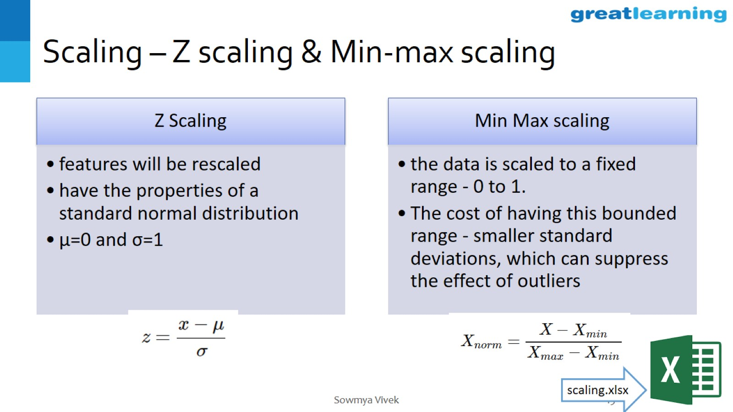
Scaling – Z scaling & Min-max scaling

Slide 16
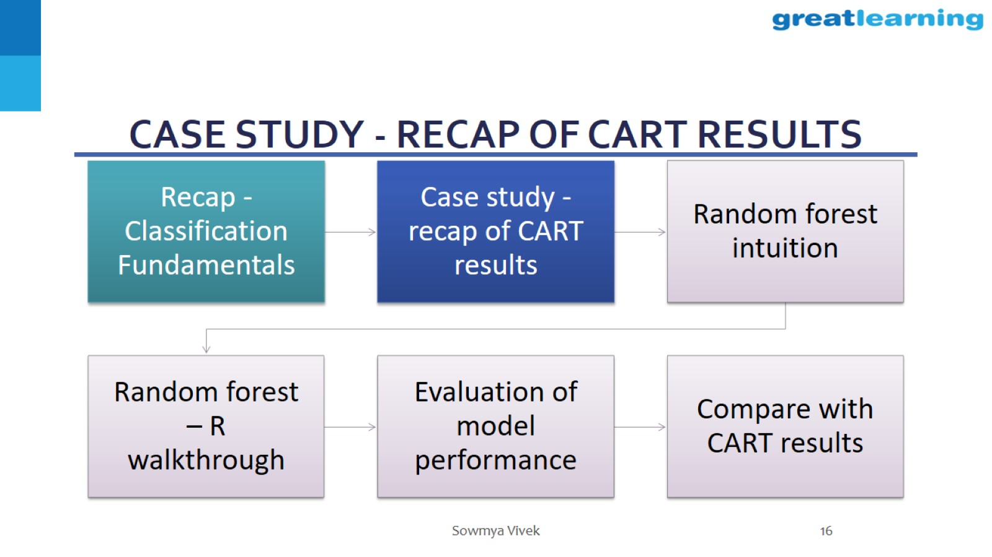
Case study - recap of CART results

Slide 17
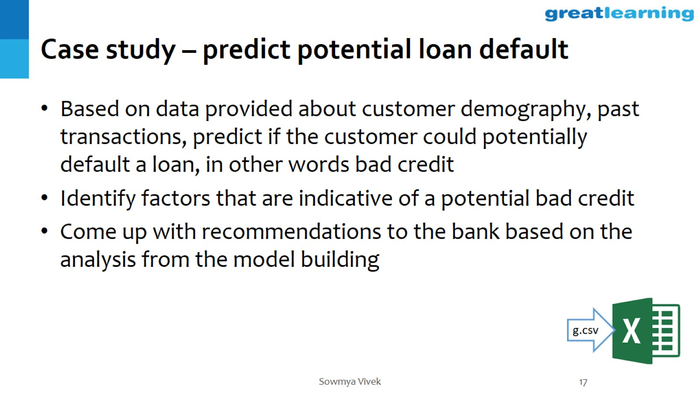
Case study – predict potential loan default

Slide 18
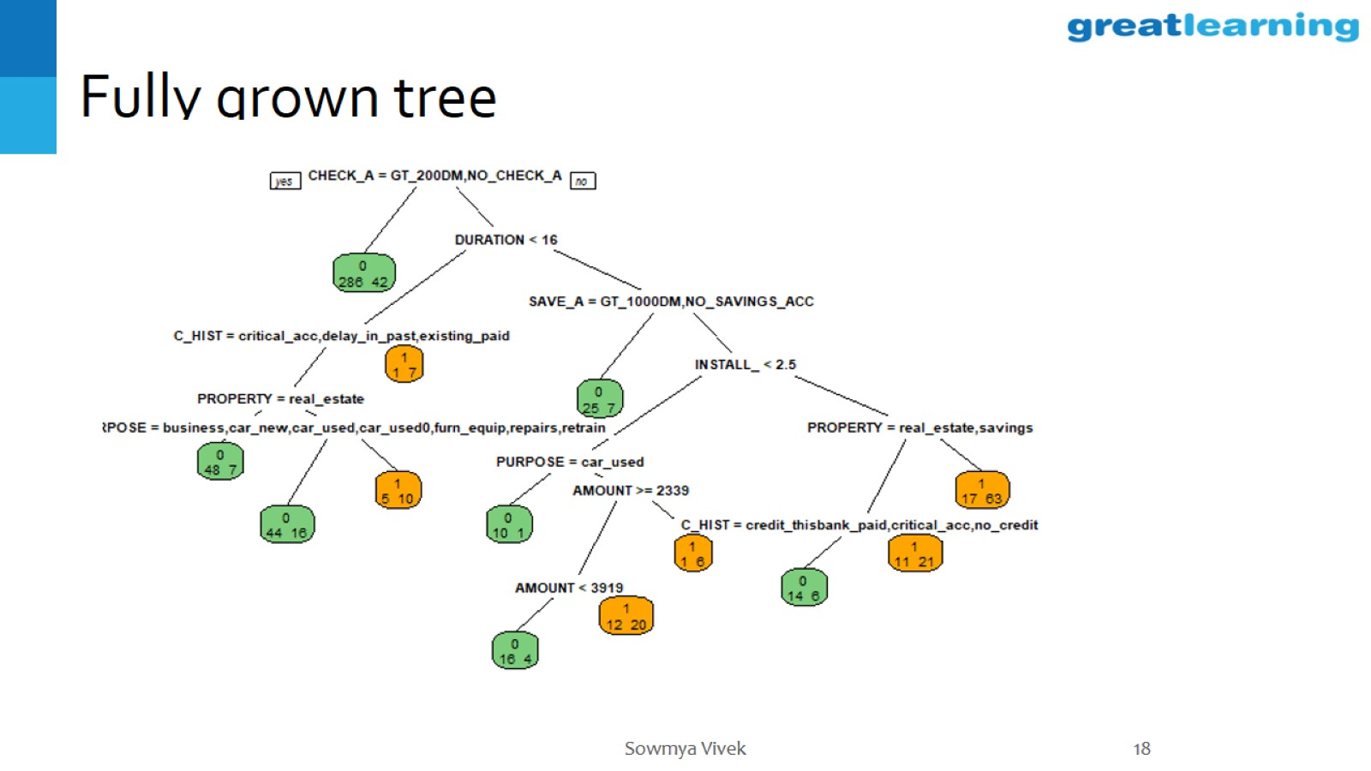
Fully grown tree

Slide 19
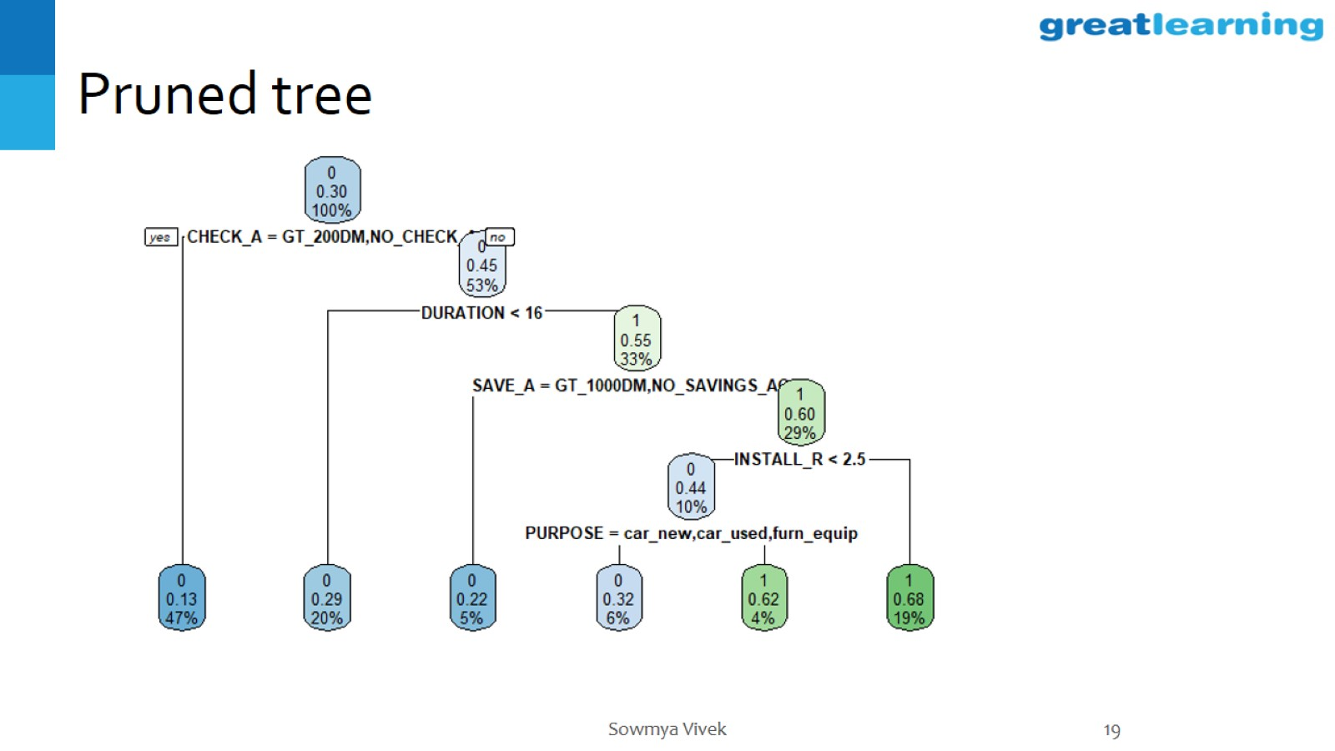
Pruned tree

Slide 20
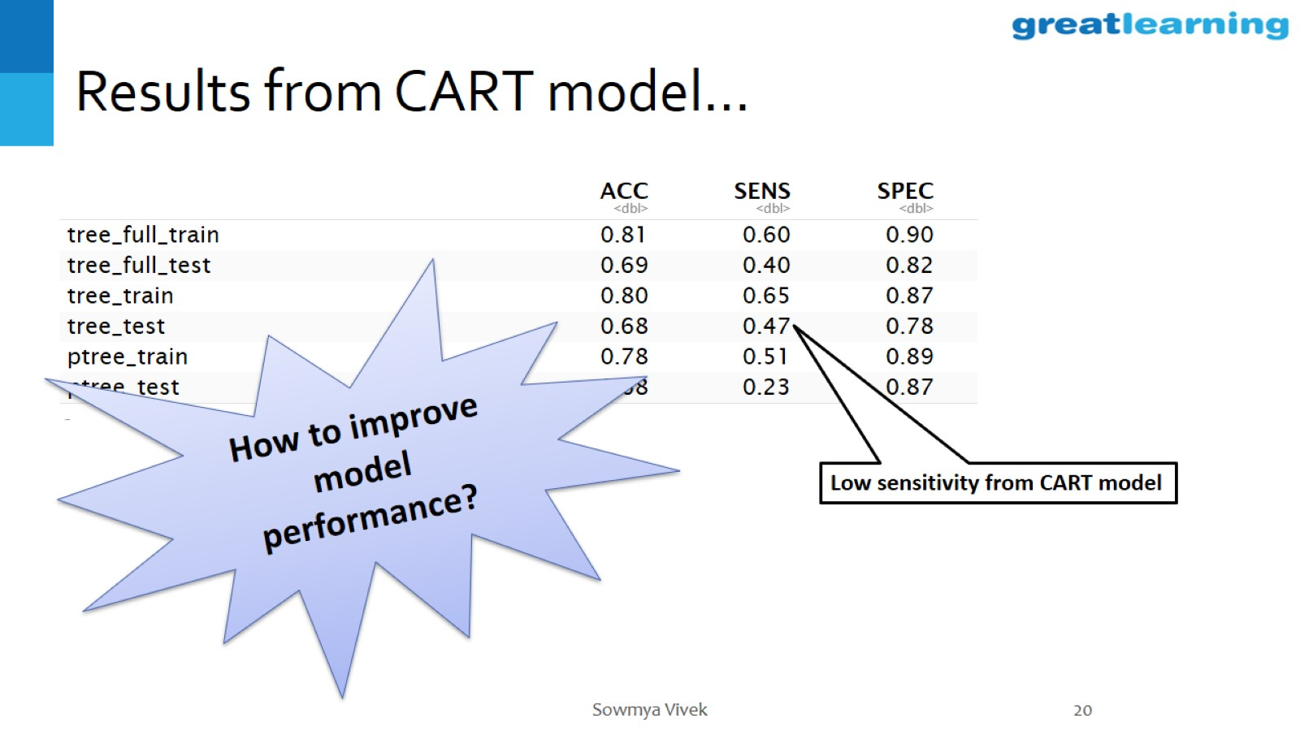
Results from CART model…

Slide 21
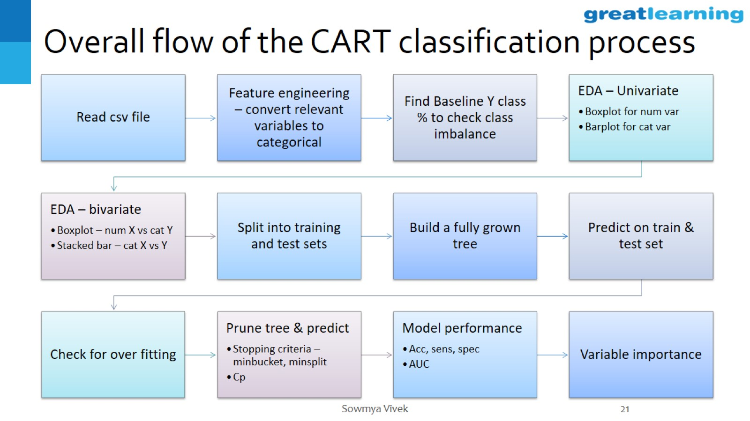
Overall flow of the CART classification process

Slide 22
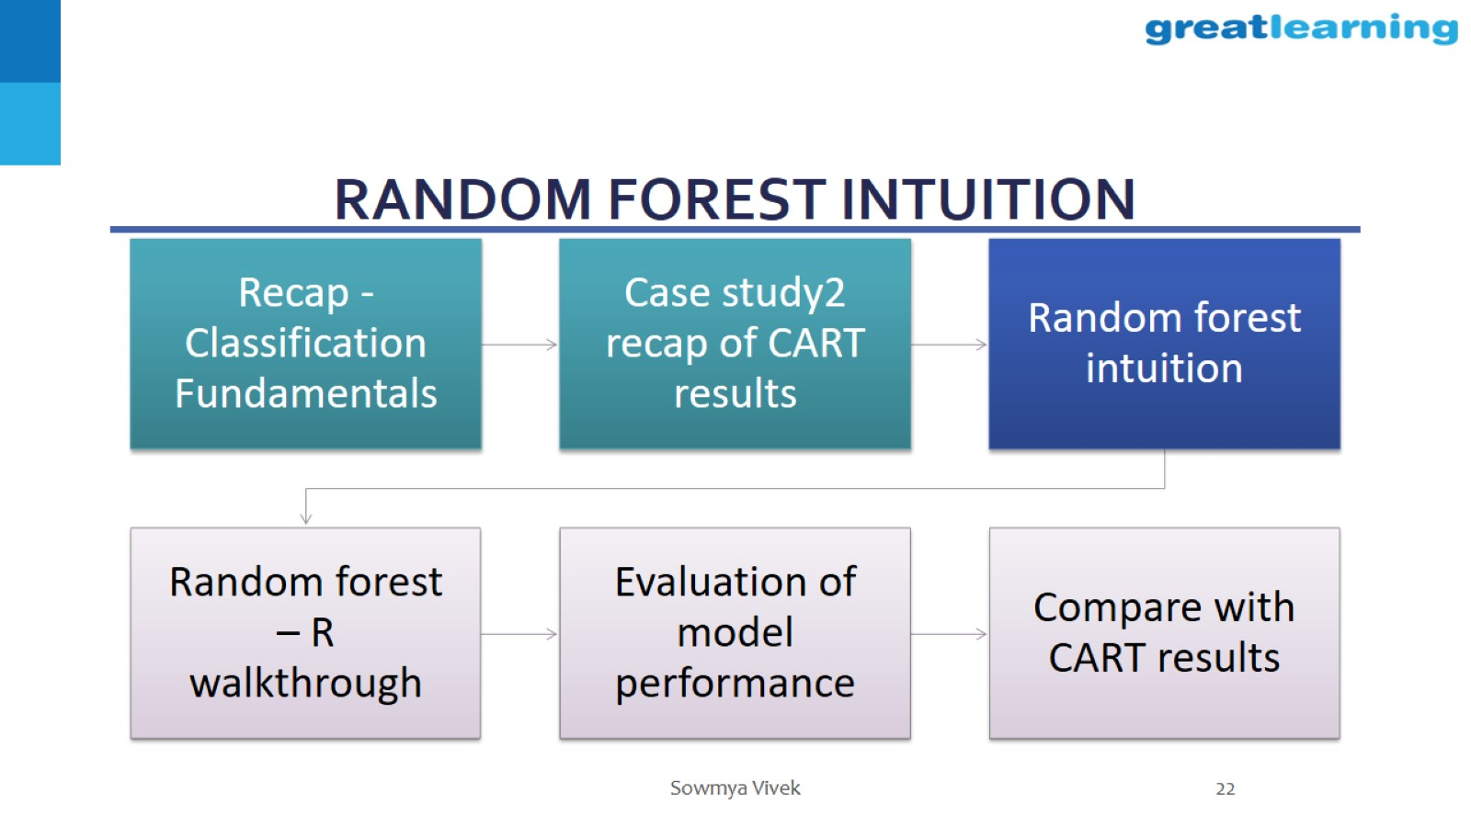
Random forest intuition

Slide 23
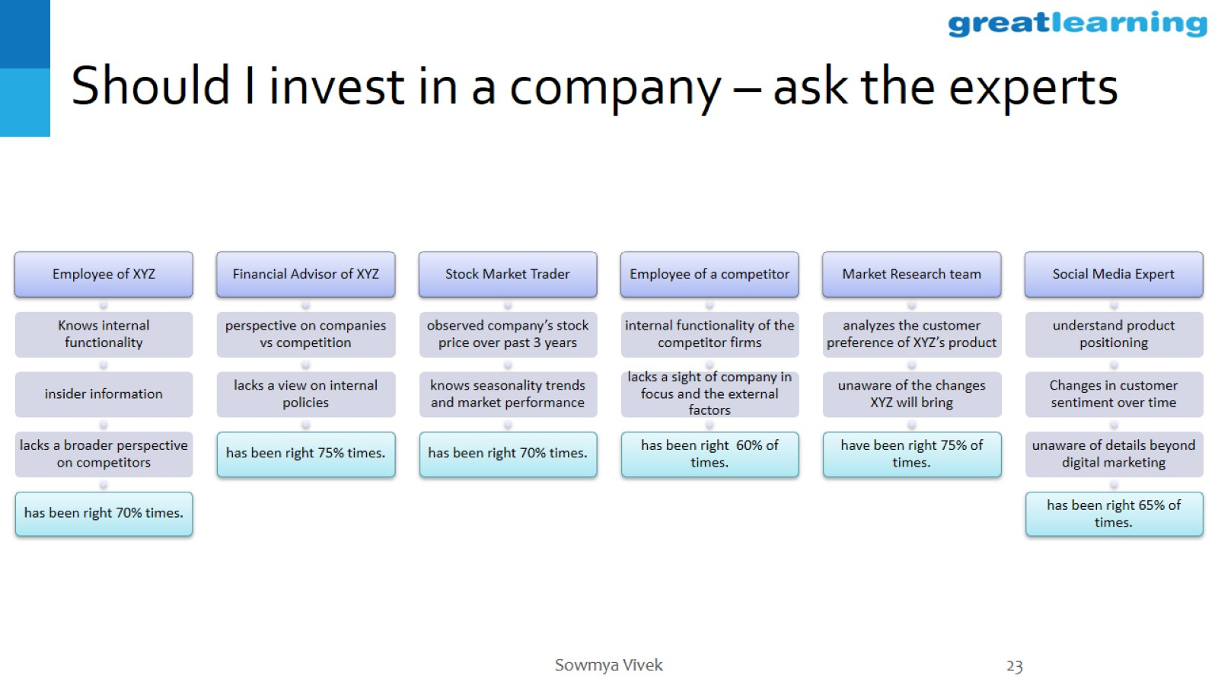
Should I invest in a company – ask the experts

Slide 24
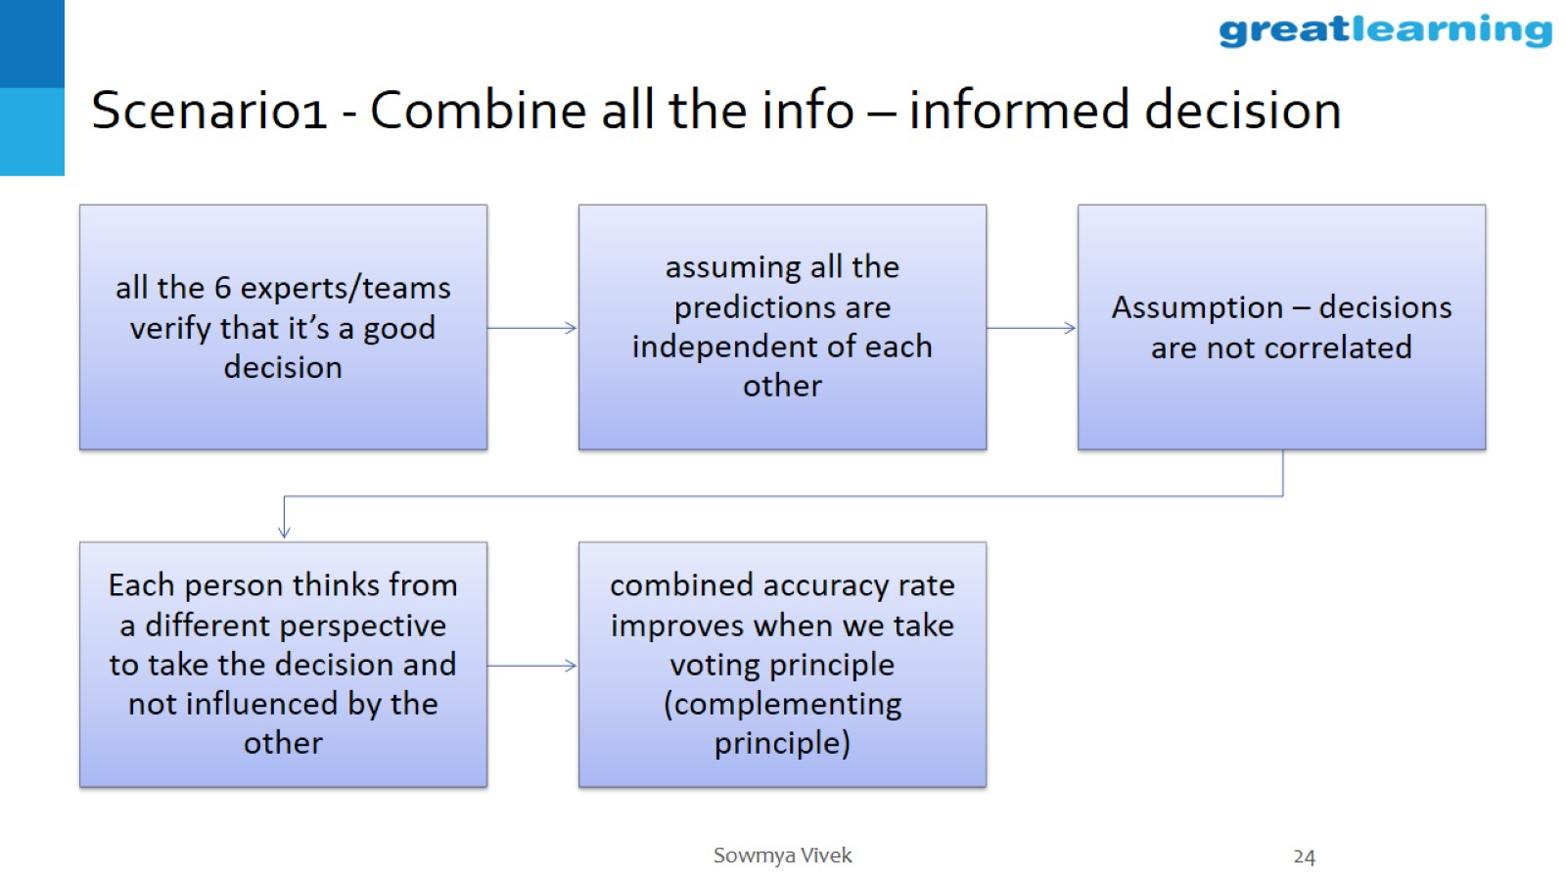
Scenario1 - Combine all the info – informed decision

Slide 25
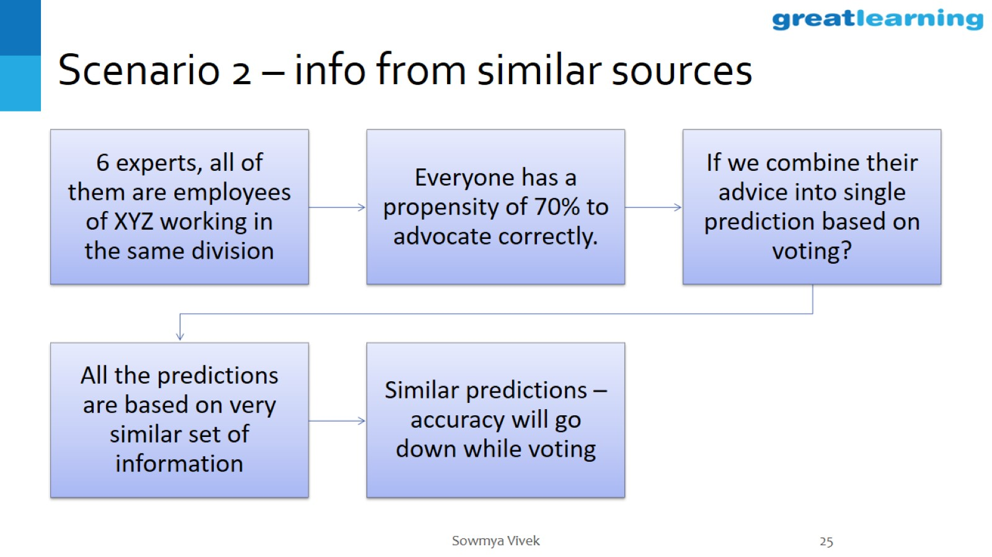
Scenario 2 – info from similar sources

Slide 26
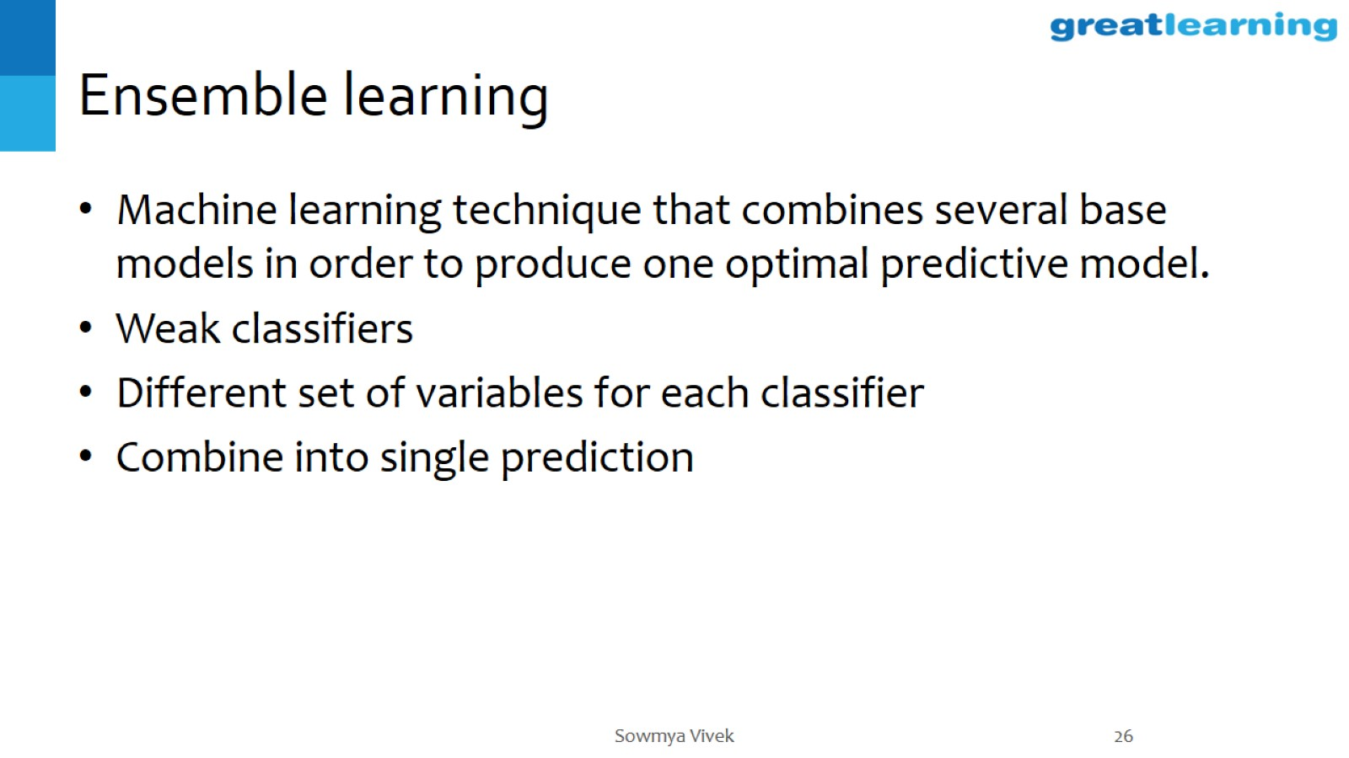
Ensemble learning

Slide 27
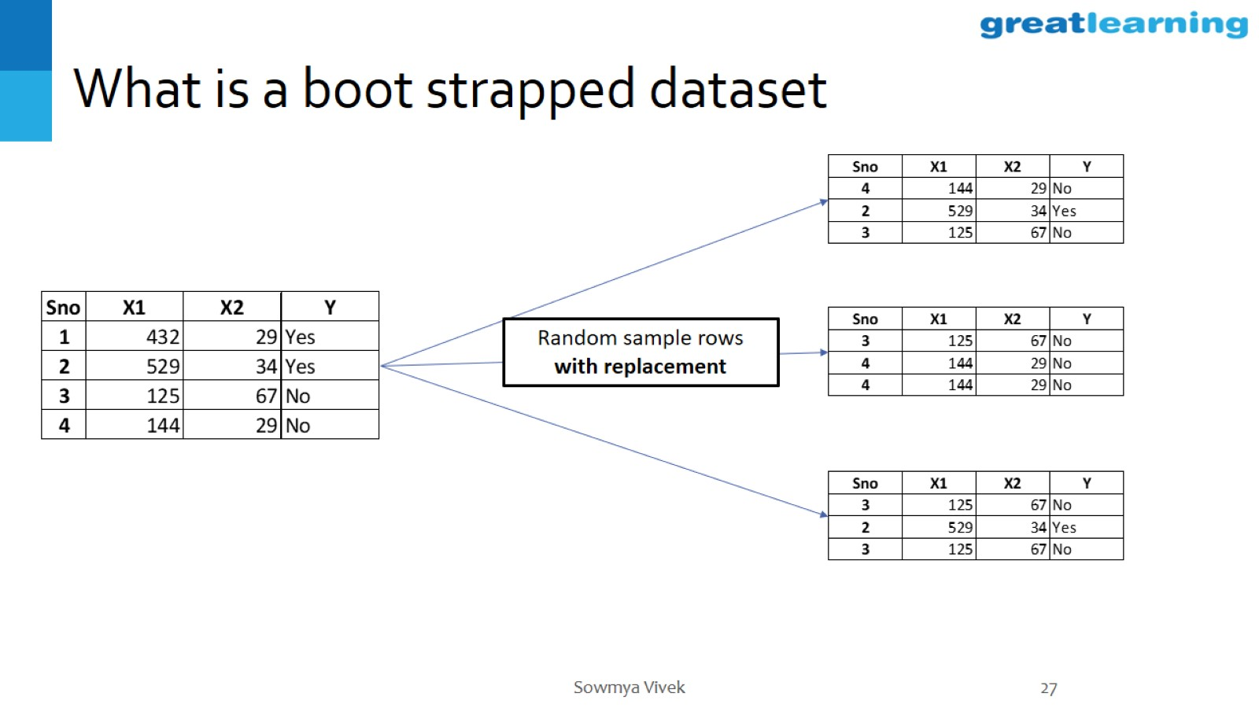
What is a boot strapped dataset

Slide 28
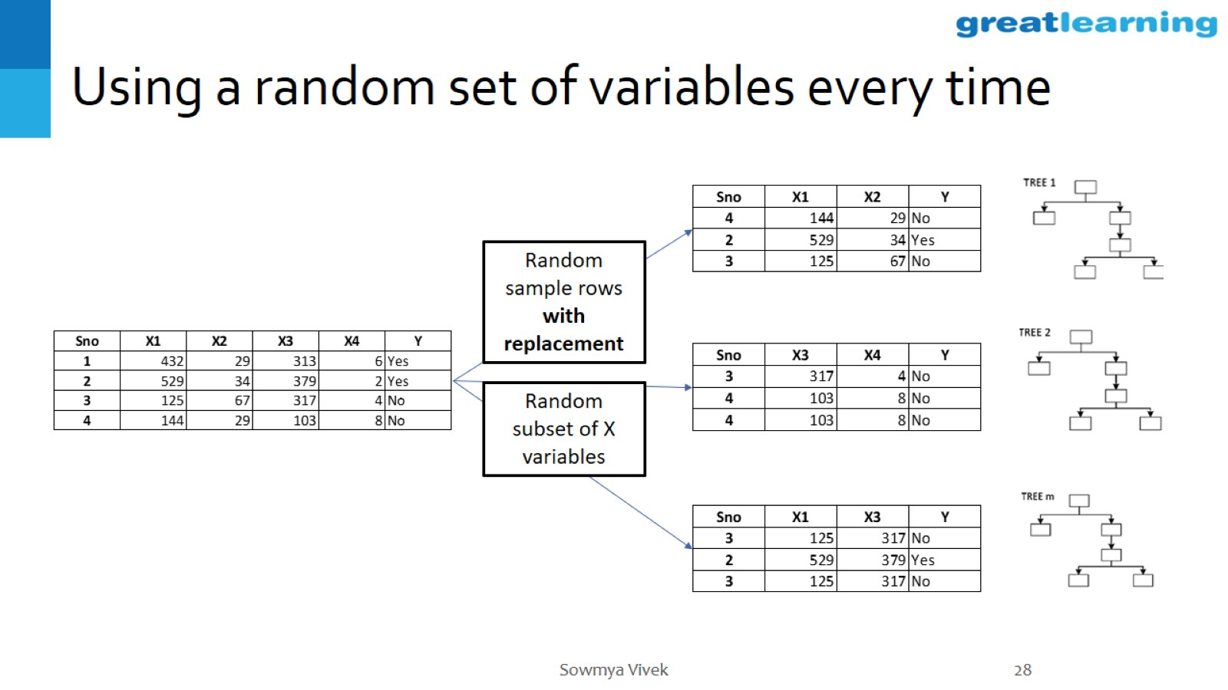
Using a random set of variables every time

Slide 29
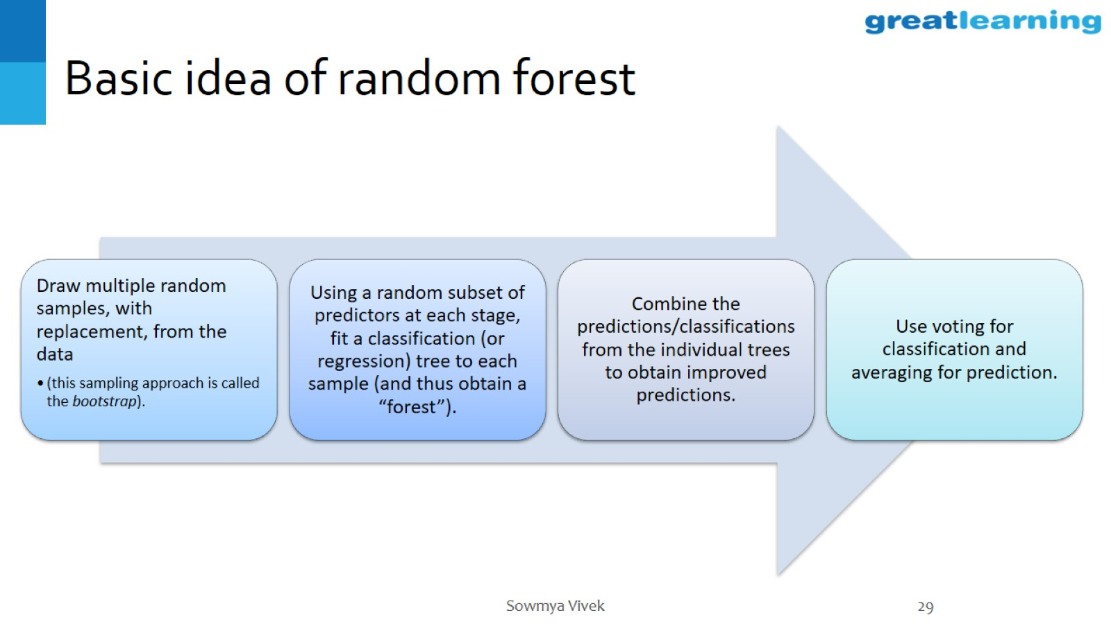
Basic idea of random forest

Slide 30
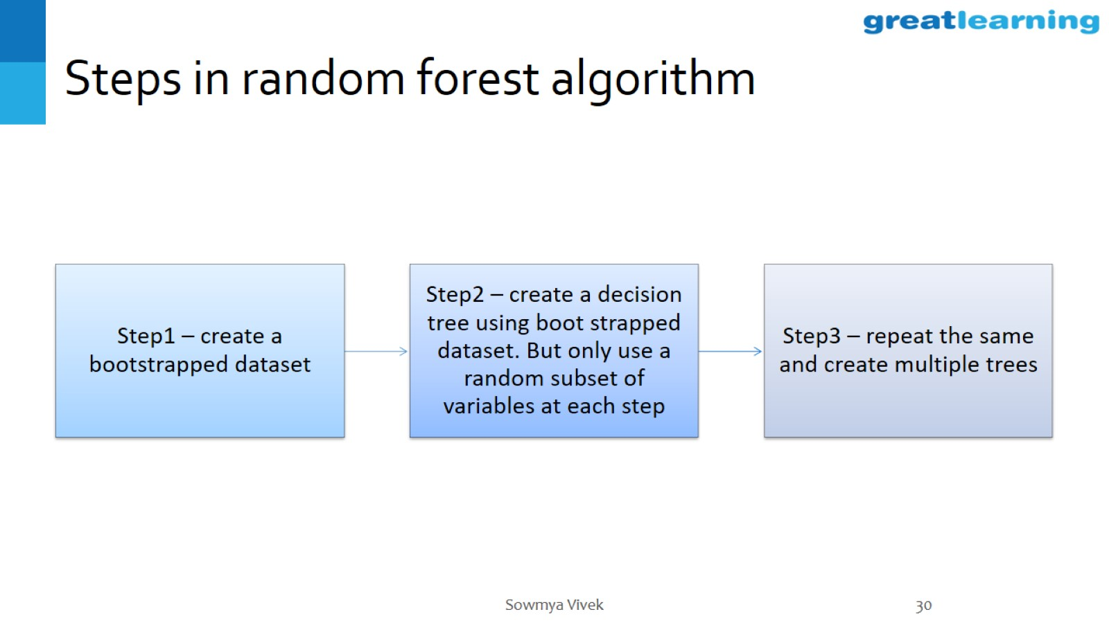
Steps in random forest algorithm

Slide 31
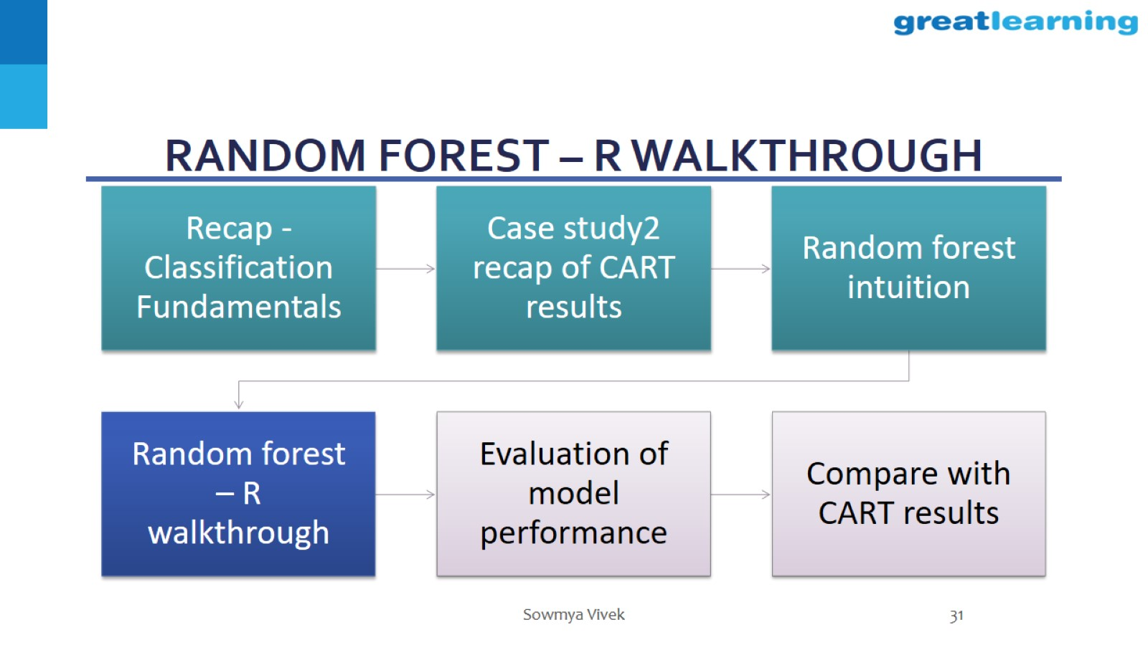
Random forest – R walkthrough

Slide 32
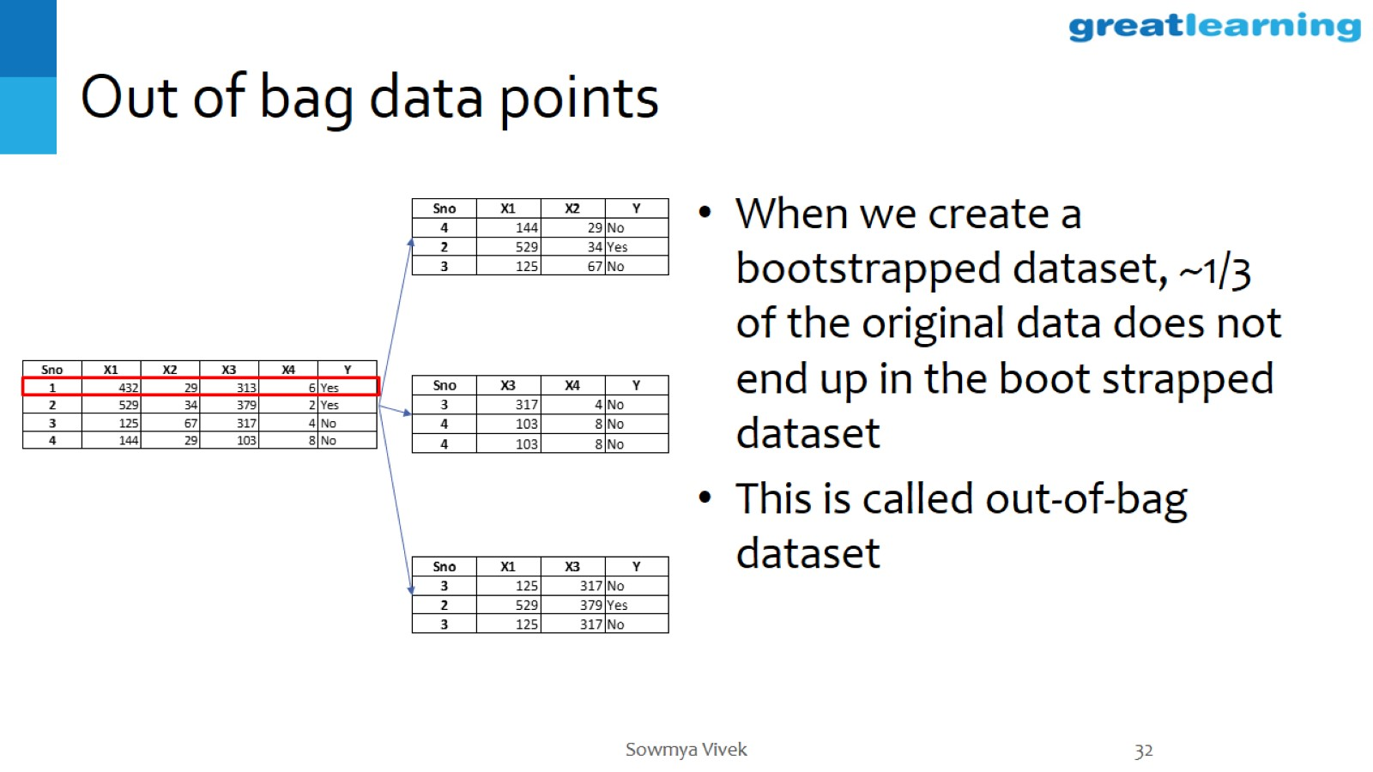
Out of bag data points

Slide 33
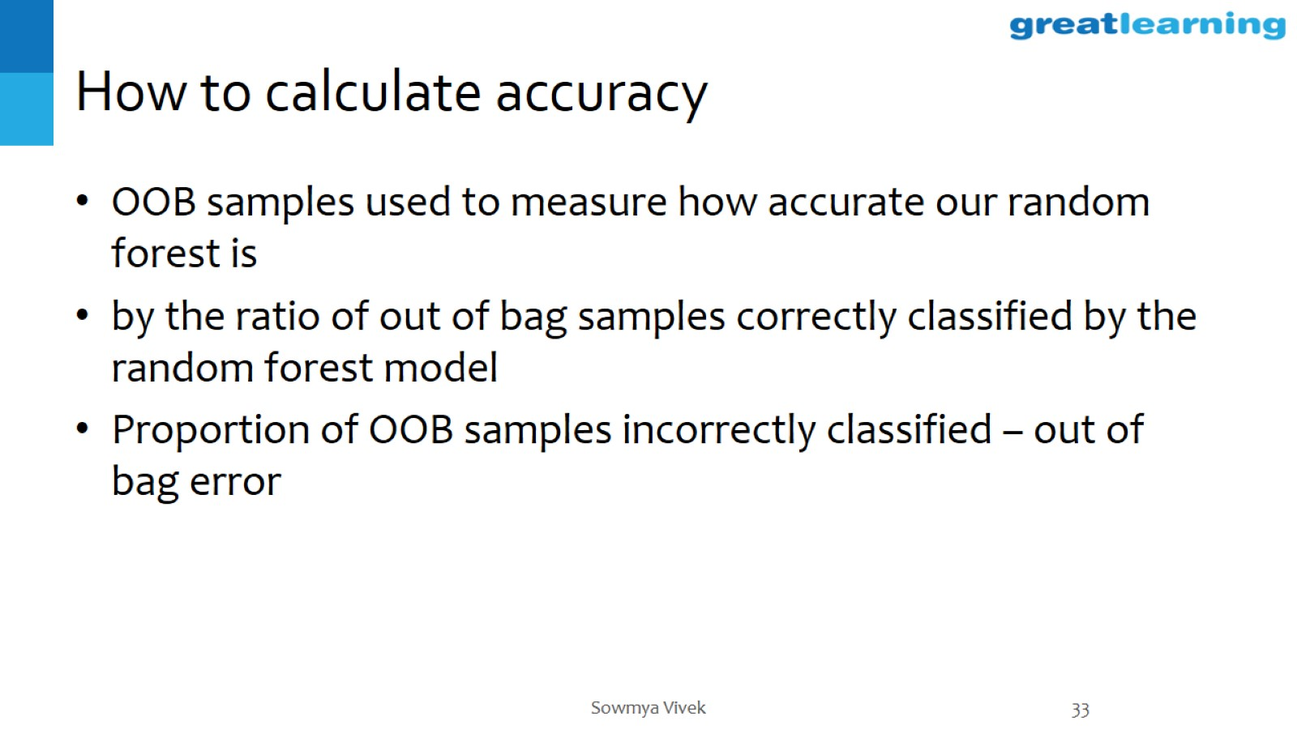
How to calculate accuracy

Slide 34
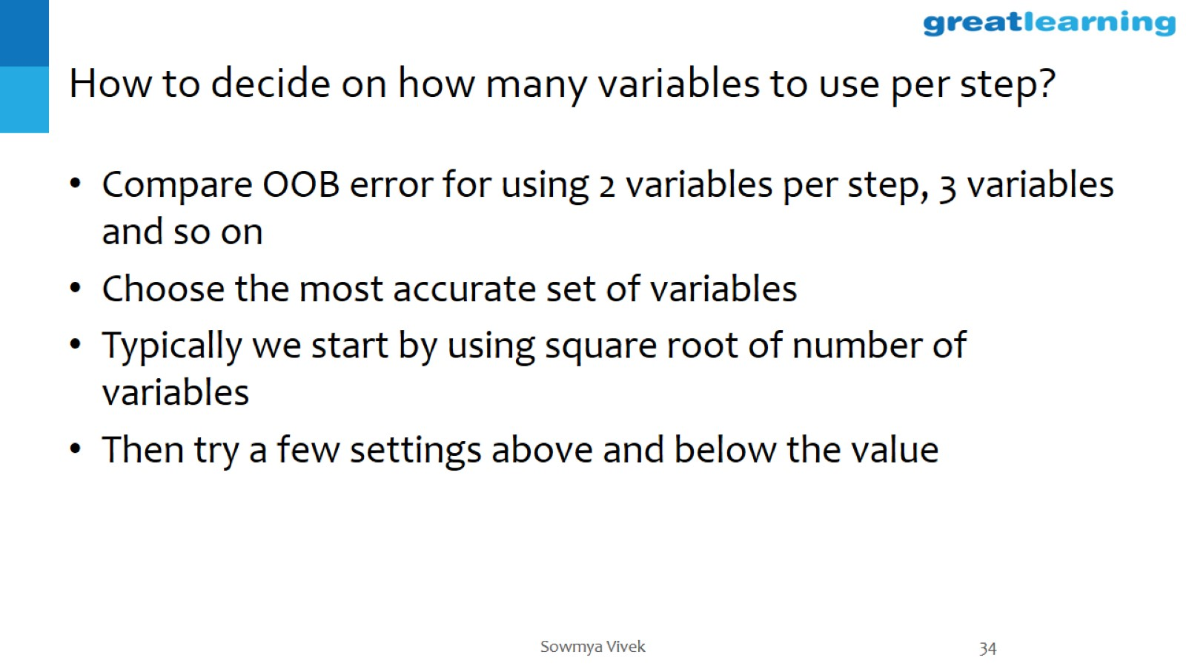
How to decide on how many variables to use per step?

Slide 35
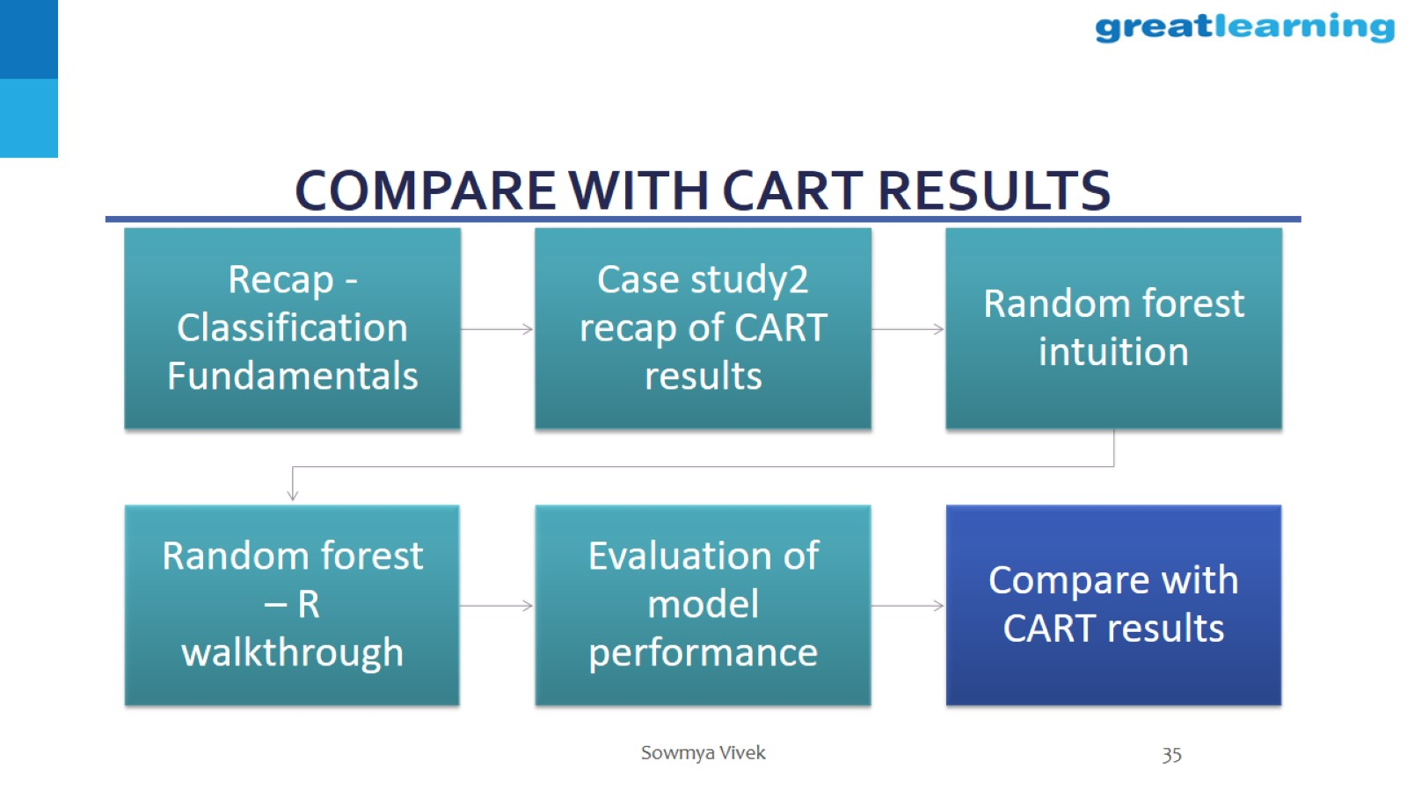
Compare with CART results

Slide 36
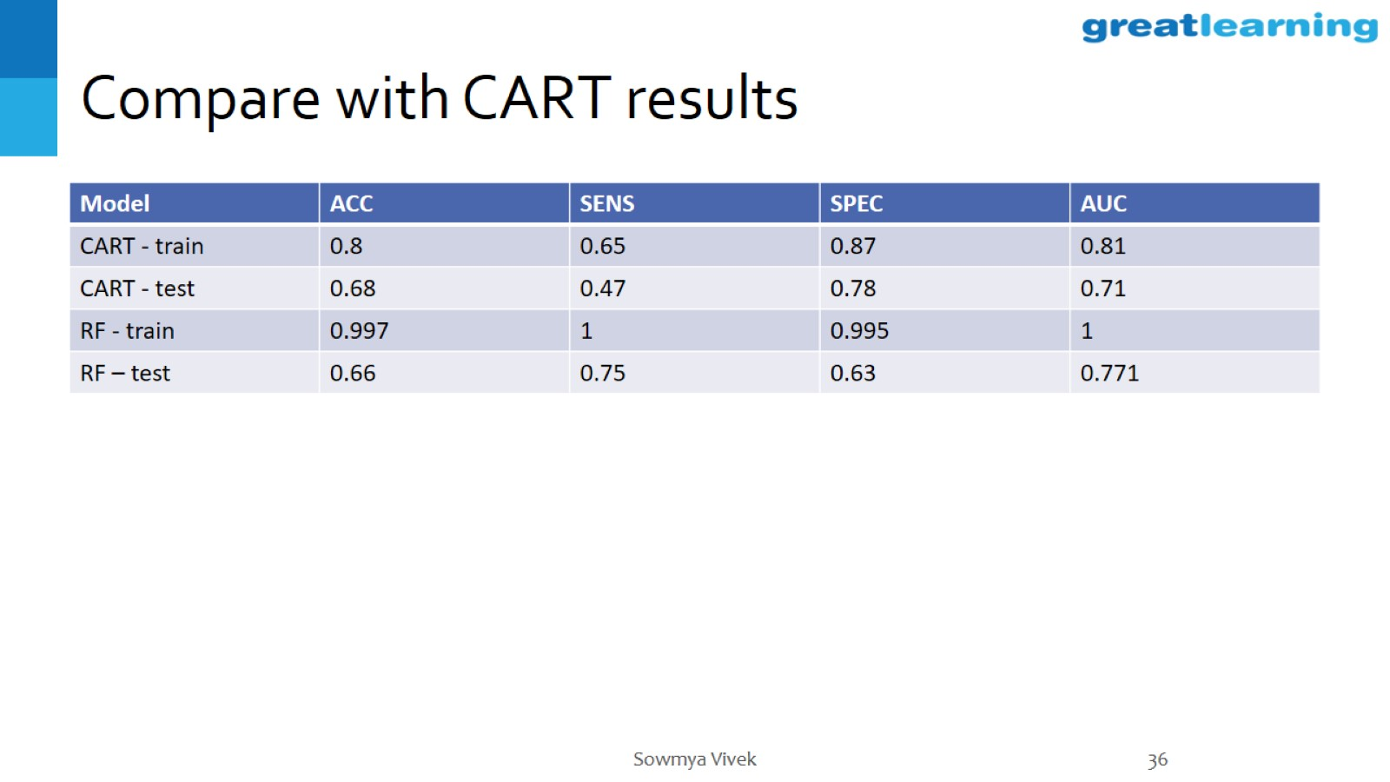
Compare with CART results

Slide 37
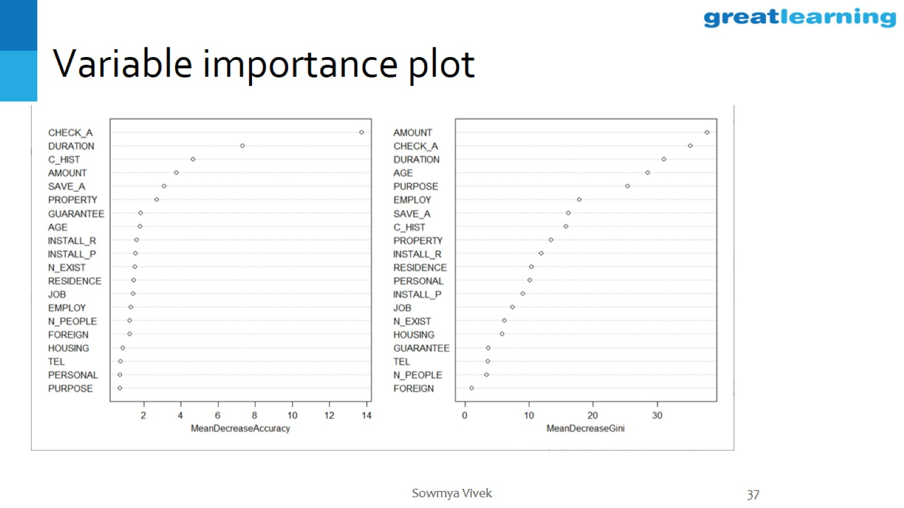
Variable importance plot

Slide 38
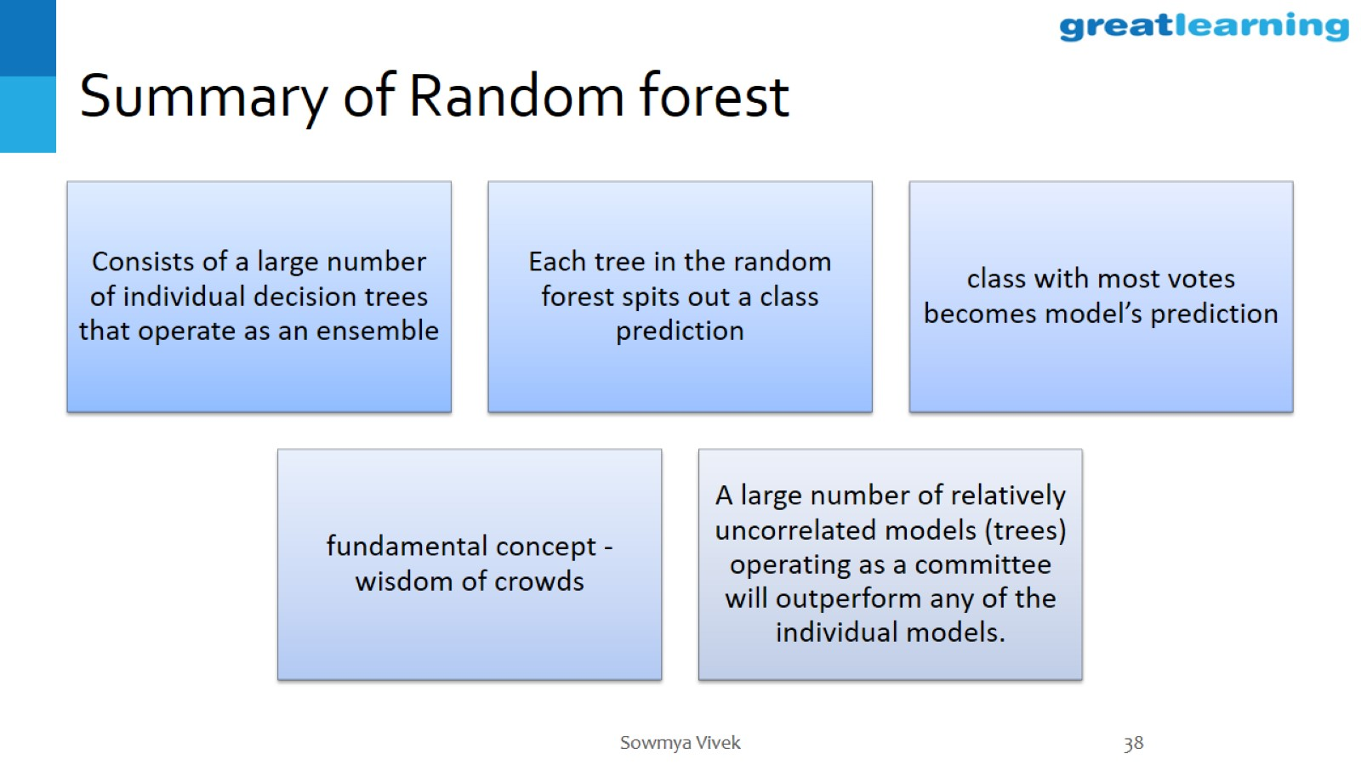
Summary of Random forest

Slide 39
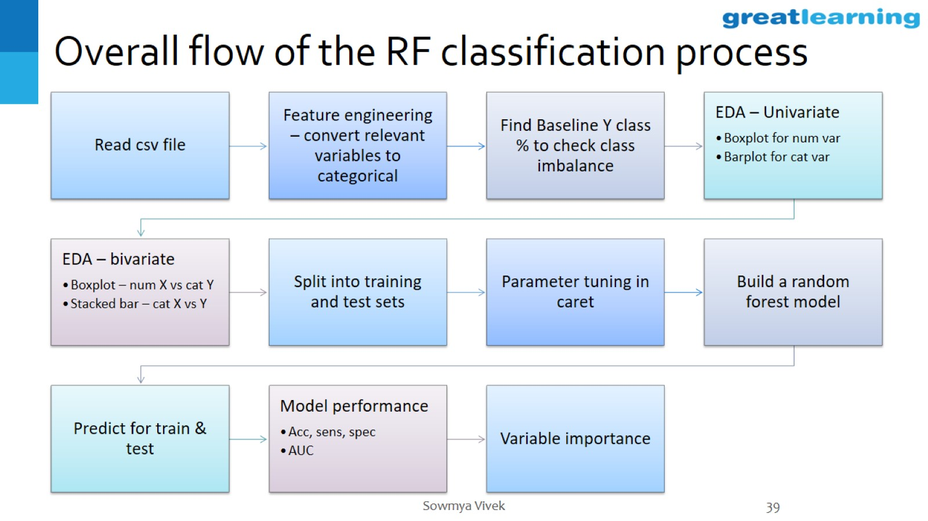
Overall flow of the RF classification process

Slide 40


